Slide 1
Introduction to Microcontollers

Slide 2
Agenda
What is a microcontroller
Introduction to Arduino
Hello World! (Blinking an LED)
Home automation (Use motion to turn on a lamp)
Robotics
Questions

Slide 3
What is a microcontroller
Integrated circuit
Used control hardware
Receives input from its environment
Controls peripherals based on a preset program

Slide 4
What is a microcontroller

Slide 5
Introduction to Arduino
Open-source physical computing platform
Based on the Atmel ATMEGA family of microcontrollers
Currently 21 different Arduino boards
Uses a C-like programming language called Wiring

Slide 6
Why use Arduino
Inexpensive
Price range $15 - $50
Cross-platform
Works with Windows, Mac and Linux
Simple programming environment
Open source software
Open source hardware

Slide 7
Additional Tools
Breadboard/Prototyping board
Wire snips/stripper
Needle-nose pliers
Screw drivers
Lots of wire
Multimeter
Soldering Iron
Helping hands
Circuit design software
3D Printer

Slide 8
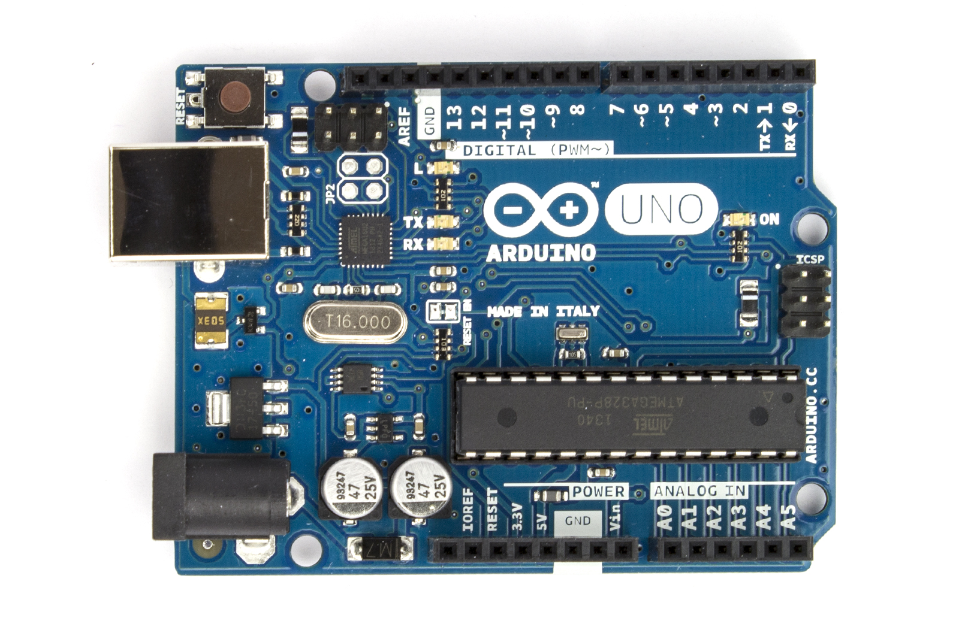
Arduino Uno

Slide 9
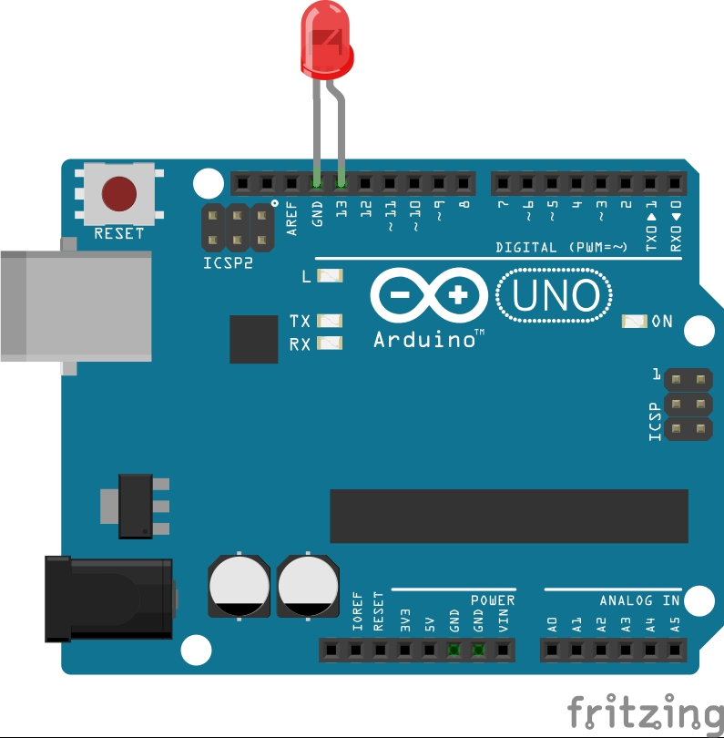
Hello World!
Arduino Uno
LED
Button
Resistor

Slide 10
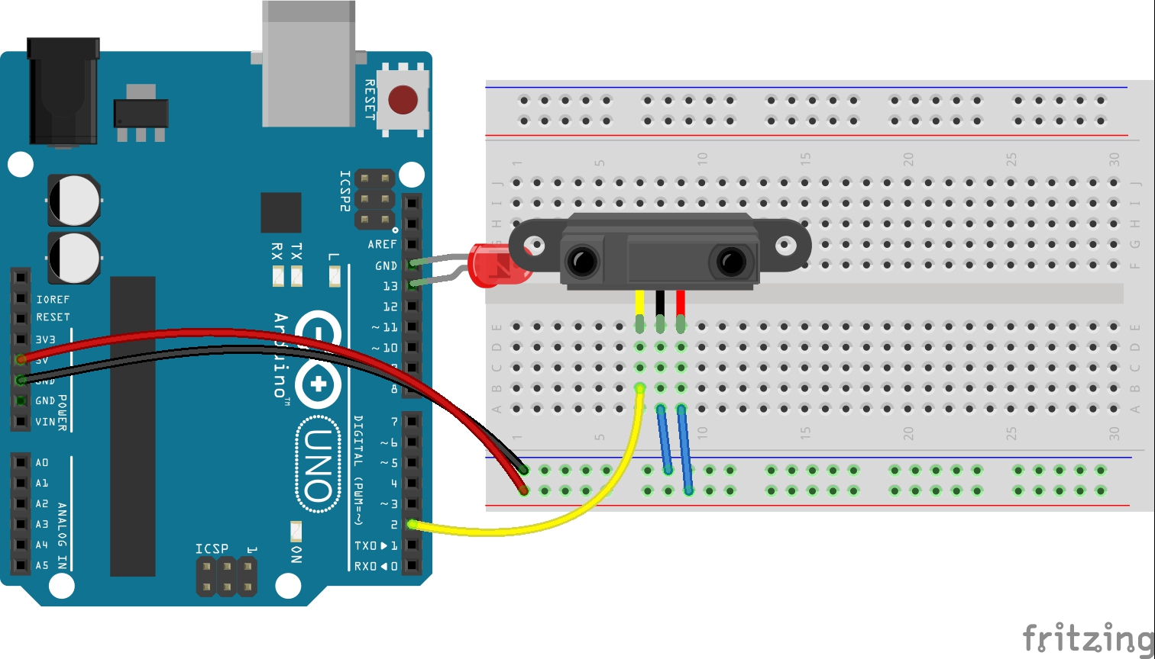
Home automation
Ardiuno Uno
Parallax PIR sensor
LED

Slide 11
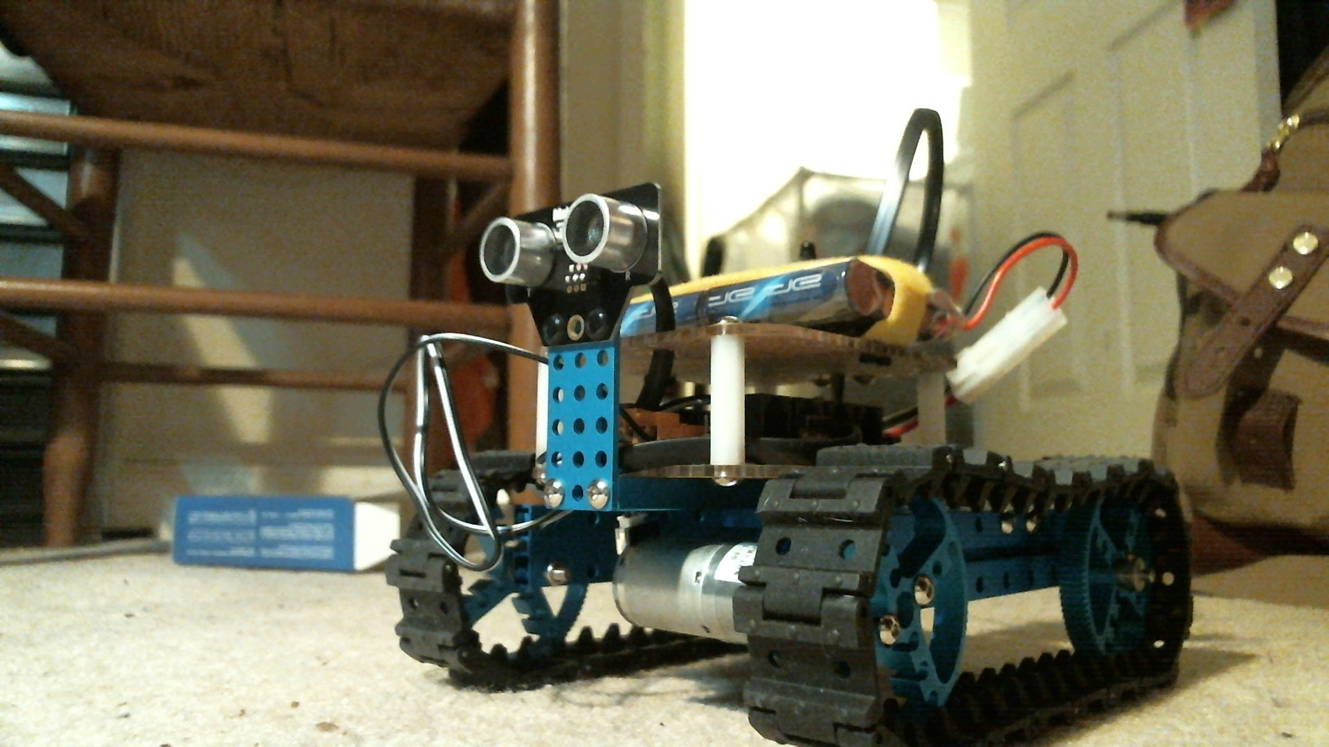
Robotics
Arduino Uno
Motor shield
Ping Sensor
DC Motors
Chasis

Slide 12
Questions?

Slide 13
Resources
iT2Pi – www.it2pi.org
Arduino – www.arduino.cc
Adafruit – www.adafruit.com
Sparkfun – www.sparkfun.com
Make Magazine – www.makezine.com

